Slide 1

WHERE TO MAKE SUSHI
Battle of the Neighbourhoods

Slide 2
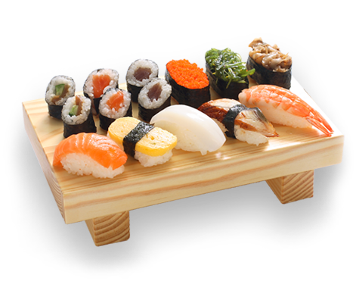
BUSINESS PROBLEM
You are planning to open a Japanese restaurant in the Western half of Toronto City.
Which neighborhoods are your best bets to be successful

Slide 3

APPROACH
1
Find the best areas to set up restaurants using data about locations (venues) in Toronto West
Further analyze the competition to further drill down on a possible location
2

Slide 4

DATA SOURCES
Toronto Postal Codes / Neighborhood data from Wikipedia
Location data from COCL.US
GEOPY Call for coordinates
Venue data via Foursquare API
1
2
3
4

Slide 5

DATA CLEANING & SELECTION
1
Basic cleansing steps like analyzing and removal of NULLS is required.
Data from Postal code is taken as the base → Coordinate data is added to this from COCL.US site → This is used to pull venue data from each location.
Since we are focusing on West Toronto, the CN Tower is taken as border all coordinate to the West of CN Tower are retained.
One-hot encoding is done from the venues obtained from Foursquare which is the base of the analysis.
The data is changed into frequency and modeled so we get the top 10 venues for each location after the require grouping is done.
2
3
4
5

Slide 6
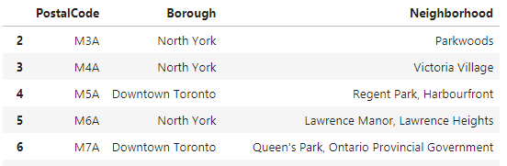
METHODOLOGY
Reading the Postal Code Data
Data was read using Pandas, with html5lib as flavor. Blank data was dropped as required. The initial dataframe is as below:
Using Geospatial data, Latitude & Longitude are added to this.

Slide 7
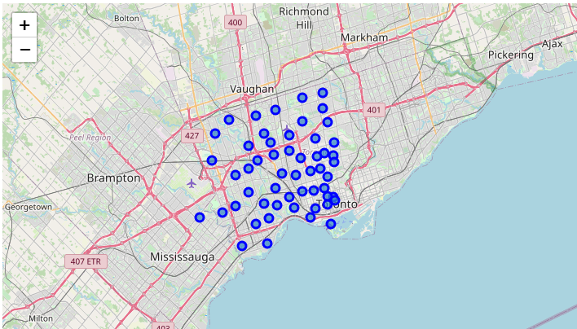
METHODOLOGY
Refining the data to only Western half of Toronto
The next step is to pick out only West Toronto with that being the target area of this analysis. This was achieved by deleting data east of the coordinates of CN Tower

Slide 8
Acquiring Venue data from Foursquare & Processing
Venue of top 100 places within 500m of the locations are procured with calls to the Foursquare API.
For each neighborhood we get a json file
Data is appended to a dataframe
After grouping by Neighborhood, we use one hot encoding to break up the venues
From this we the frequency of the top 10 venues in that location
The data is now ready for Cluster Analysis
METHODOLOGY

Slide 9
Cluster Analysis
For this analysis, to determine the different area cluster we turn to k-means
k-means clustering is a method of vector quantization, originally from signal processing, that aims to partition n observations into k clusters in which each observation belongs to the cluster with the nearest mean (cluster centers or cluster centroid), serving as a prototype of the cluster.
METHODOLOGY

Slide 10
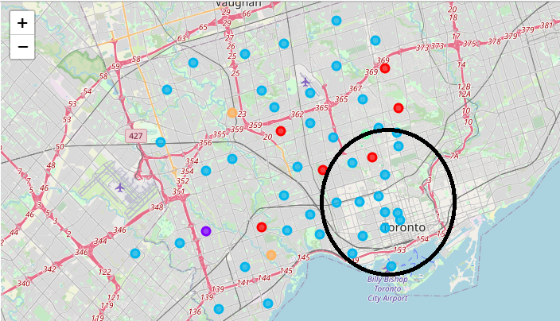
Cluster Analysis
Post using kmeans, we generate our output visually. On analysis of the 5 clusters venues cluster 2 (light blue) seems to be the best neighborhoods for restaurant. The circled area shows the highest concentration of neighborhoods
METHODOLOGY

Slide 11
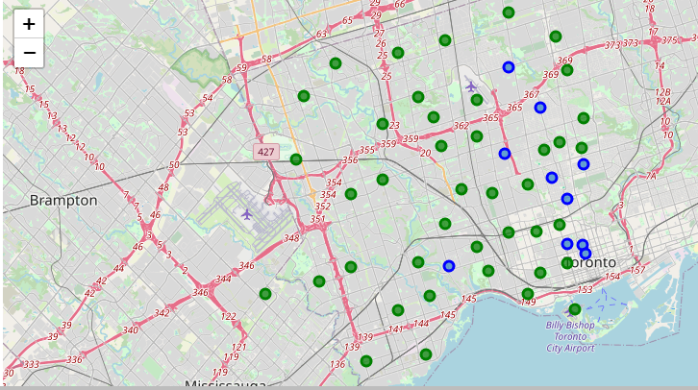
Drilling down to Existing Japanese Restaurants
Picking out only cluster 2, we delve further into where existing restaurants are present
The blue points show existing Japanese / Sushi Restaurants in Cluster 2.
Green points are cluster 2 neighborhoods without Japanese Restaurants.
METHODOLOGY

Slide 12
RECOMMENDATION
The K means clustering clearly shows Cluster 2 has being the main cluster for restaurants. The South East corner of the Grid has a particular density around restaurants making it a good choice for your new restaurant.
However looking at the distribution of existing Japanese Restaurants in the grid we can visually see that there are already a plethora of Japanese restaurants in this area which would be unnecessary competition.

Slide 13
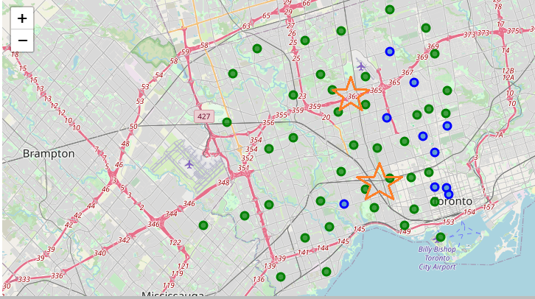
RECOMMENDATION
Neighborhoods in the marked areas may have a better bet as they are also popular for restaurants and there will be a lack of competition with other Japanese outlets.
These areas are also sufficiently close the neighborhoods where cluster 2 is dense and popular for restaurants
Being more West may also make your restaurant first choice for the entire western part of West Toronto as it will be one of the closest to them.

Slide 14
THANK YOU

